Slide 1
Protein Pow(d)er
Programmeertheorie, Week 2, Presenteersessie 1
Team: Shire Peasants 3
Authors: Mark Dzoljic, Loek van Steijn, Sebastiaan Kruize

Slide 2
Format of the presentation
1. Introduction in the casus
State Space of the problem (Mark)
2. Datastructures (Terugblik vorige week) (Loek)
Dictionairy vs. Matrix
Results
3. Algorithms (Sebas)
Random, Greedy
4. Results (Sebas)
Future heuristieken (Allemaal)
5. Q&A and discussion (Mark)

Slide 3
1. Introduction: Stability of proteins
Proteins fulfill numerous function inside the human body
Consist of a ’string’ of amino-acids
Faulty proteins linked to diseases such as Alzheimers or huntington
Finding “Stable” Proteins can help in the development of farmaceuticals

Slide 4
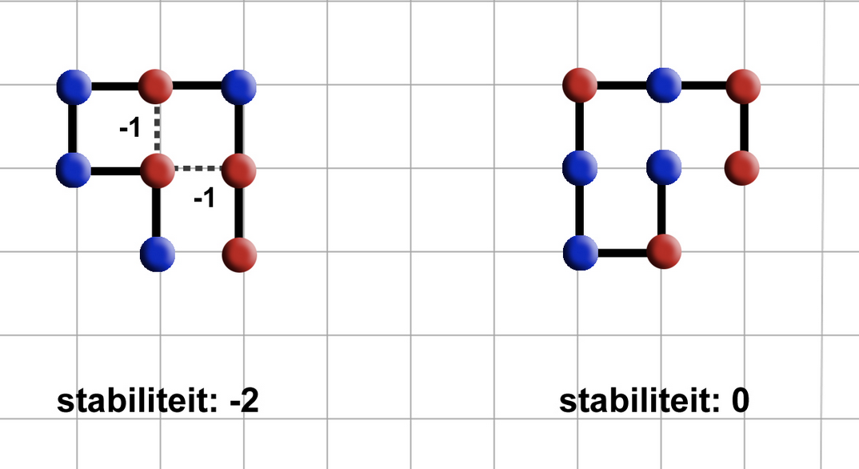
1. Introduction: Stability of proteins
Place amino-acids on a 2D-grid.
Amino acids can be hydrophic (Red) or Polair (Blue)
Red amino-acids can form bridges, and strengthen the stability
Goal is to find protein structures that are as stable as possible.

Slide 5
1. Case exploration
Constrained Optimization Problem
Constraints
Amino-acid string is given
All amino-acids must be used
Can not move ‘diagonally’ must move either left/right/up/down
Amino-acids cannot overlap
Optimization
Legitimate solution with the highest stability
State Space
4^{n}?
4*3^{n-1}
Maar: rotatie
3^{n-2}
Kan niet rekening houden met self-avoiding walk:
True State Space: < 3^{n-2}

Slide 6
2. Quick recap
Element Object
Stores: coordinates, direction, type
Lattice Object
Stores: element objects in two ways
Dictionaries
Use of dictionaries to store element objects.
Matrixes (2D or 3D grid)
Use of a matrix to store element objects.
Question: which data structure is faster?

Slide 7
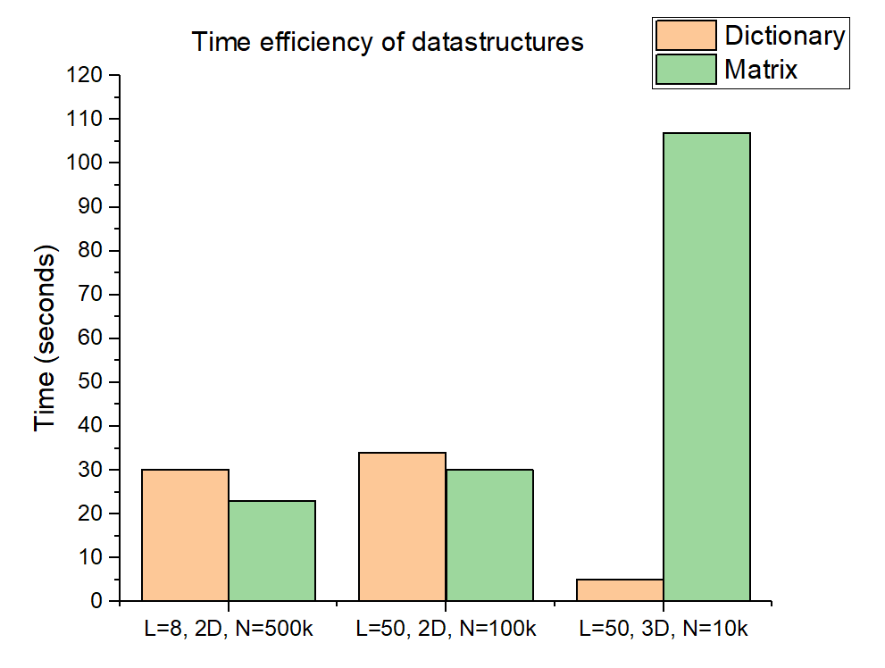
Results – Data structure
L: length of protein
N: number of iterations

Slide 8
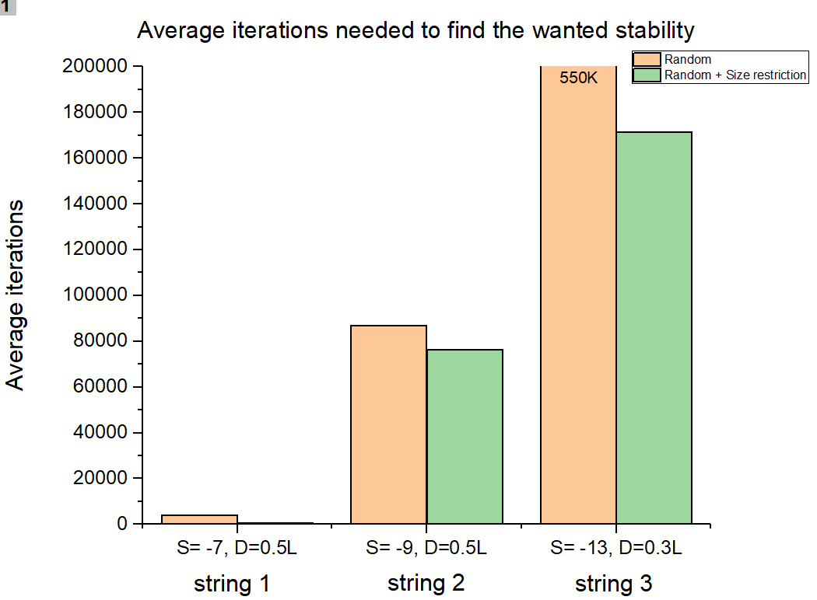
Results – Size restricted configuration
S: wanted stability
D: dimension of matrix
L: length of protein
String 1 (L=14): HHPHHHPHPHHHPH
String 2 (L=20): HPHPPHHPHPPHPHHPPHPH
String 3 (L=36): PPPHHPPHHPPPPPHHHHHHHPPHHPPPPHHPPHPP

Slide 9
Conclusions
Data structures
Size restriction
Situation | Matrix (time) | Dictionary (time) | Improvement
L=8, 2D, N=5E⁵ | 23 s | 30 s | +23%
L=50, 2D, N=1E⁵ | 30 s | 34 s | +12%
L=50, 3D, N=1E⁴ | 107 s | 5 s | -2040%
Situation | Random iterations | Size restricted iterations | Improvement
S=-7, L=14, D=0.5L | 4076 | 555 | +86%
S=-9, L=20, D=0.5L | 86881 | 76272 | +12%
S=-13, L=36, D=0.3L | 530253 | 171503 | +67%

Slide 10
3. Algorithms
Suboptimal results:
Random
Greedy
Optimal results
Linear algorithm

Slide 11
4. Method: Possible algorithms
Name | Result | Method | Ω (Best Case) | Runtime (1000 iterations) Dict | Runtime (1000 iterations) Matrix
Random | Sub-optimal | Constructive
Greedy | Sub-optimal+ | Constructive
Lineair | Optimal | Constructive
Future | - | -

Slide 12
Future:
Welke heuristieken gaan we komende week aan werken.

Slide 13
Questions and comments?
Our questions:
All our algorithms are ‘constructive’. Ideas where to think regarding iterative algorithms?
What is your view on our choice for datastructure?
Thank you for your attention

